Slide 1

Indian Institute of Information Technology, Allahabad
Mini Semester Project On
Unsupervised
Word Sense Disambiguation
Submitted By -
1. Vikhyat Tandon ( IIT2011203)
2. Vikash Kumar ( IIT2011209)
3. Shubham Mishra ( IIT2011211)
Under the guidance of :
Prof. U. S. Tiwary
IIIT - ALLAHABAD

Slide 2
What is Word Sense?
Lewis Caroll (1875) Once Said
“When I use a word, it means just what I choose it to mean – neither more nor less.”
Words may have different senses and these senses depend upon its context.
Humans guess the meaning of the word from their knowledge.
But for computers it’s a really typical and tough job and we are interested in it .

Slide 3
Introduction
What is WSD(Word Sense Disambiguation)?
It is an open problem of natural language processing, which governs the process of identifying which sense of a word (i.e. meaning) is used in a sentence, when the word has multiple meanings.

Slide 4
A Simple Example:-
(a) I have to turn round around the circle.
(b) Round of the championship this season.
Here the word “round” has different sense :
In (a) it means moving in a circular motion.
In (b) it means different phases of the game progress.
So now our task is to find the meaning of word “round” in our sentence.

Slide 5
Computers and WSD :-
The computer needs to learn how to associate a word sense with a word in context using either machine learning or manual creation of rules or metrics.
Main focus of this report is the use of Unsupervised Approach for WSD.

Slide 6
Problem Definition
Word sense disambiguation (WSD) involves the association of a word sense with a word in context using either machine learning or manual creation of rules.
The aim of this project is to develop a Unsupervised WSD technique which can handle all these issues with better accuracy and performance. This report presents our preliminary work towards solving the problem.

Slide 7
Motivation
Word sense disambiguation (WSD) is essence of communication in a natural language. It is motivated by its use in many crucial applications such as :
Information retrieval,
Information extraction,
Machine translation,
Part of-Speech tagging, etc.
Hence, hereby we are motivated to develop a Unsupervised WSD technique which can handle all these issues with better accuracy and performance.

Slide 8
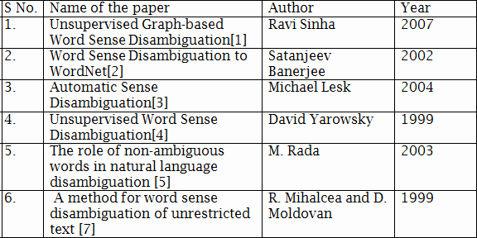
Literature Survey

Slide 9
Proposed Approach
We are using a new Unsupervised approach for Word sense disambiguation.
Earlier approaches to sense disambiguation make the use of sense tagged data of any kind during the training.
In this technique, feature vector representations of unlabeled instances are taken as input and are then grouped into clusters according to a similarity metric.
Main disadvantage is that senses are not well defined.
We are using the Graph-based method for word sense disambiguation.

Slide 10
Proposed Approach Contd.
Other Approaches to Solve the problem:
Knowledge Based :
Lesk Algorithm.
Yarowsky’s Algorithm.
Knowledge-based methods disambiguates words by matching context of the target word with information from a prescribed knowledge source
Creating and finding such a large knowledge source is practically impossible and very inefficient.

Slide 11
Proposed Approach Contd.
Unsupervised methods do clustering of words into some sets which indicate the same meaning
In this project, we describe a graph-based algorithm for unsupervised word sense disambiguation.
The algorithm annotates all the words in a text by exploiting similarities identified among word senses, and using centrality algorithms applied on the graphs encoding these sense dependencies.

Slide 12
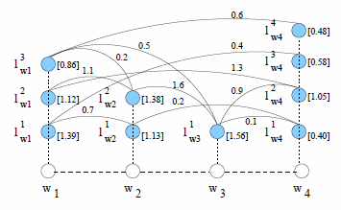
Graph-based Centrality for Word Sense Disambiguation:
Given a sequence of words W = {w1,w2, ...,wn},each word with corresponding admissible labels, we define a label graph G = (V,E) such that there is a vertex v belonging to V for every possible label . Dependencies between pairs of labels are represented as directed or in directed edges e belonging to E, defined over the set of vertex pairs V ×V . Such label dependencies can be learned from annotated data, or derived by other means.

Slide 13
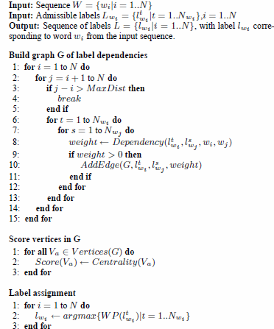
Graph Centrality for Word Sense Disambiguation

Slide 14



Label dependencies are determined through the Dependency function, which encodes the relation between word senses. We conduct our evaluation using Leacock & Chodorow similarity.
The Leacock & Chodorow similarity is determined as:
where length is the length of the shortest path between two concepts using node-counting, and D is the maximum depth of the taxonomy
The betweenness of a node is defined in terms of how “in-between” a vertex is among the other vertices in the graph.
Formally:

Slide 15
What is wordnet?
WordNet is a lexical database for the English language.^{[1]} It groups English words into sets of synonyms called synsets, provides short, general definitions, and records the various semantic relations between these synonym sets.
Hypernyms : a word with a broad meaning constituting a category into which words with more specific meanings fall.
For example, colour is a hypernym of red.

Slide 16
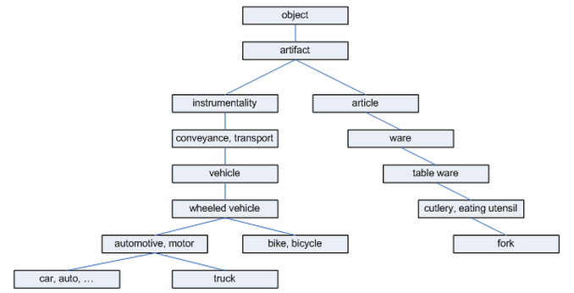
Taxonomy of Hypernyms :-
Here length between car and auto is 1, car and truck is 3 ,car and bike is 4 and car and fork is 12.
The value of D = 8

Slide 17
Hardware and Software Used
1. | Language Used : | Core Java
2. | Algorithm Used: | Graph Centrality And Dependency
3. | IDE Used : | Net Beans 7.4
4. | Dictionary Used | English WordNet2.1
5. | OS | Windows 7
6. | Processor | Intel i5 @2.4GHz
7. | Memory | 4GB

Slide 18
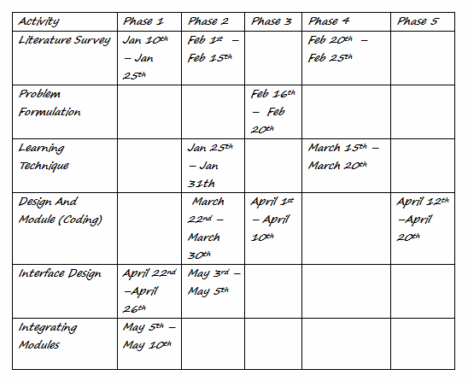
Activity Chart Table

Slide 19
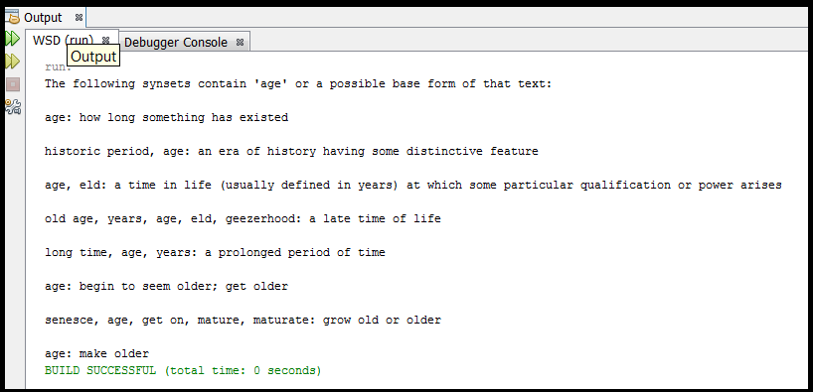
Report
The software is developed which is implementing the proposed problem definition in a well-structured manner. It associates a word sense with a word in context using unsupervised approach.
Working software snapshots:
Using wordnet in java for getting synsets

Slide 20
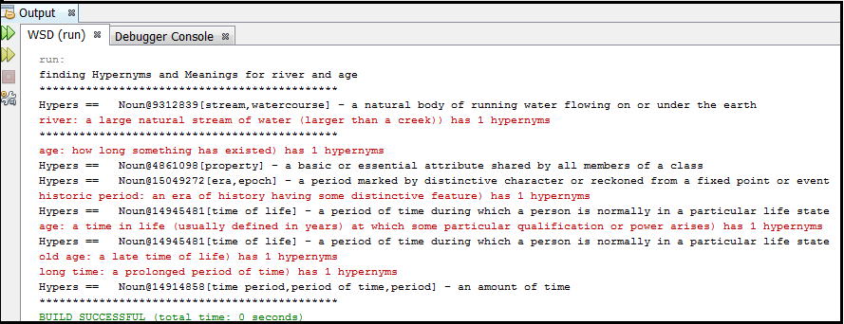
Getting Hypernyms of words

Slide 21
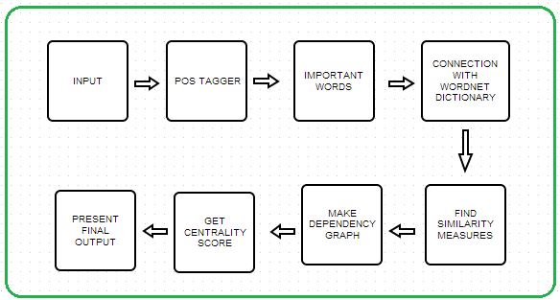
Software Basic Model :-
Flow Chart

Slide 22
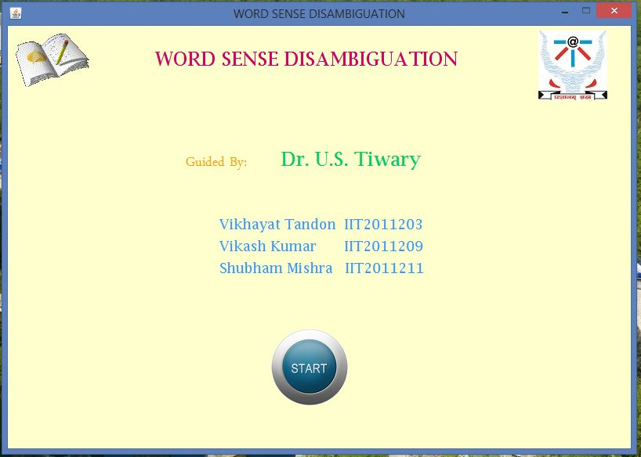
Homepage

Slide 23
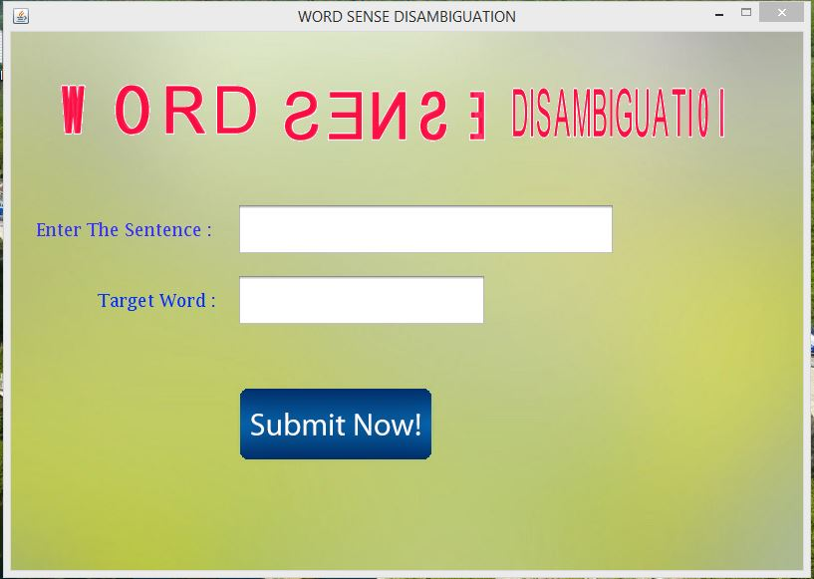

Slide 24
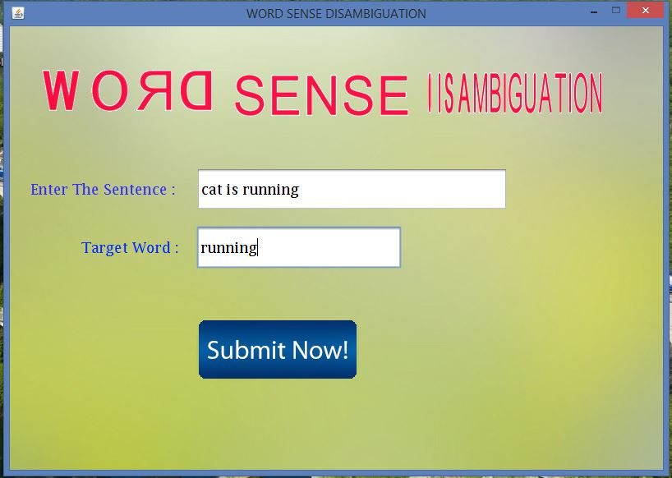
A simple example

Slide 25
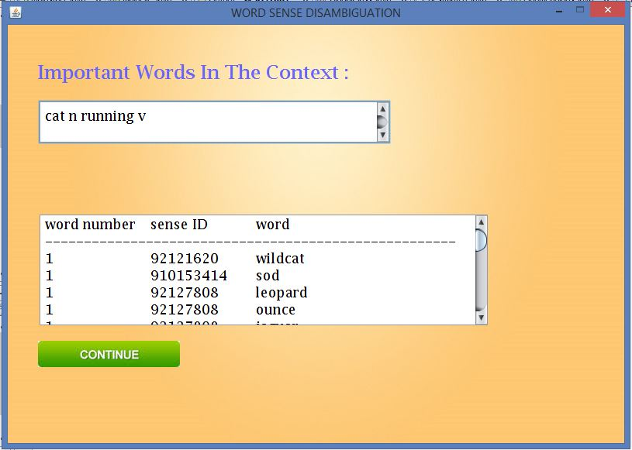
Important Words

Slide 26
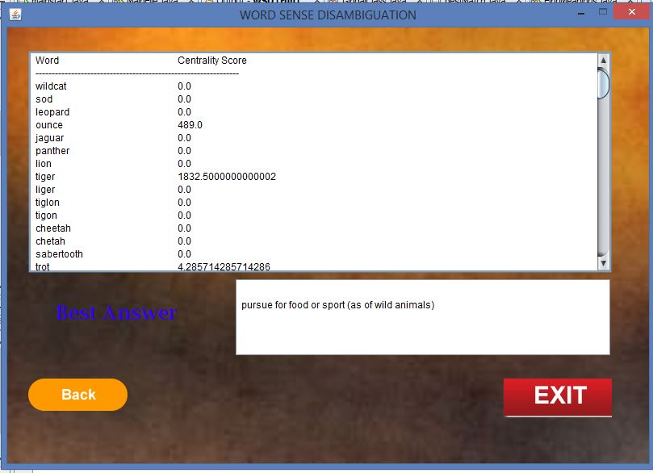
Answer

Slide 27
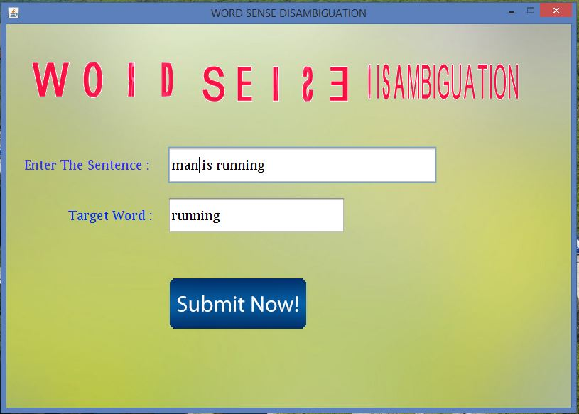
Other Example

Slide 28
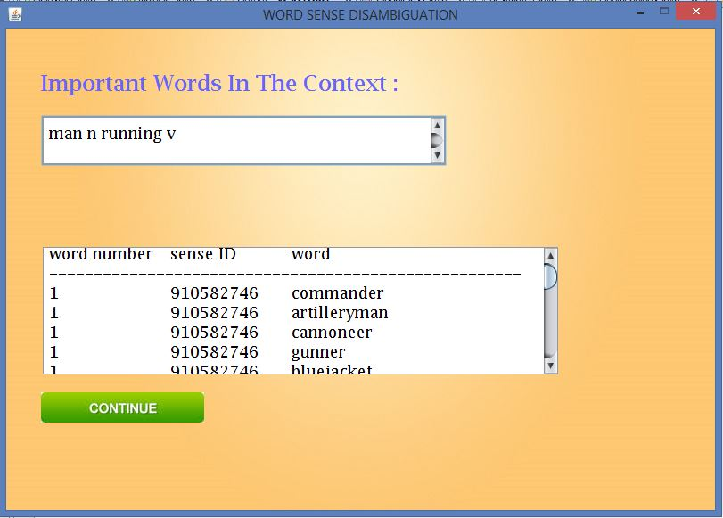
Important Words

Slide 29
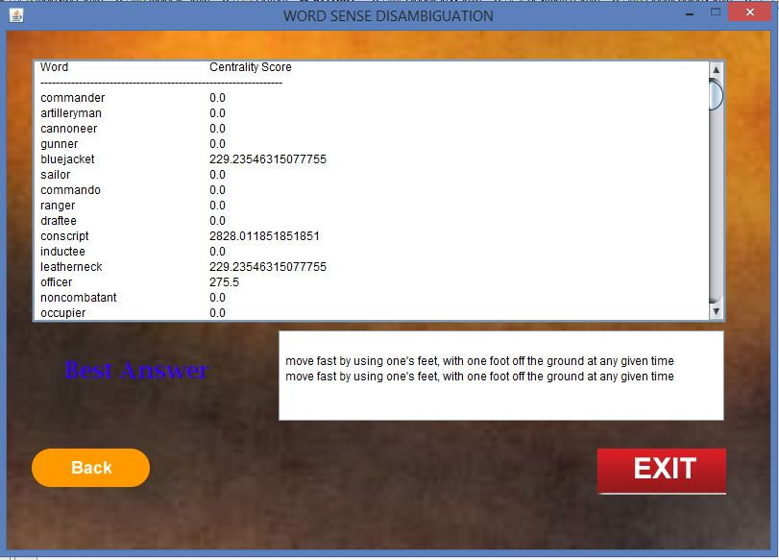
Answer

Slide 30
Consider two simple examples shown above in demo pics:
1. Cat is running
2. Man is running
Target word = “running”
For the first sentence the software returns the meaning of the target word as “chasing by animals for food” whereas in the second sentence it indicates the “physical activity”.
We used many such examples for further testing purpose and the results were quite satisfactory.
We tested the results of a dataset from wordnet having approx one lakhs entries.
Accuracy was 57%.

Slide 31
Conclusion
Our software provides a solution for unsupervised word sense disambiguation problem that is fast, scalable, efficient in terms of performance and accuracy and more useful for various applications such as Information retrieval, Machine Translation, etc. In Machine translations, it helps in better understanding of source language and generation of sentences in target language. It is also useful in Text to Speech translation i.e, when words are pronounced in more than one way depending on their meaning. For example: “lead” can be “in front of” or “type of metal”.

Slide 32
References
[1] Ravi Sinha. “Unsupervised Graph-based Word Sense Disambiguation”, University of North Texas, June 2007
[2] Satanjeev Banerjee.” Word Sense Disambiguation to WordNet”, December 2002
[3] Michael Lesk.” Automatic Sense Disambiguation”, Bell Communications Research Morristown, 200
[4] David Yarowsky.” Unsupervised Word Sense Disambiguation”, University of Philadelphia,1999
[5] “Graph based centrality algorithm”, Internet:
http://en.wikipedia.org/wiki/Centrality
[6] M. Rada.”The role of non-ambiguous words in natural language disambiguation”, 2003.
[7] R. Mihalcea and D. Moldovan.” A method for word sense disambiguation of unrestricted text”, 1999.

Slide 33
THANK YOU

